Slide 1
Medieval Instruments

Slide 2
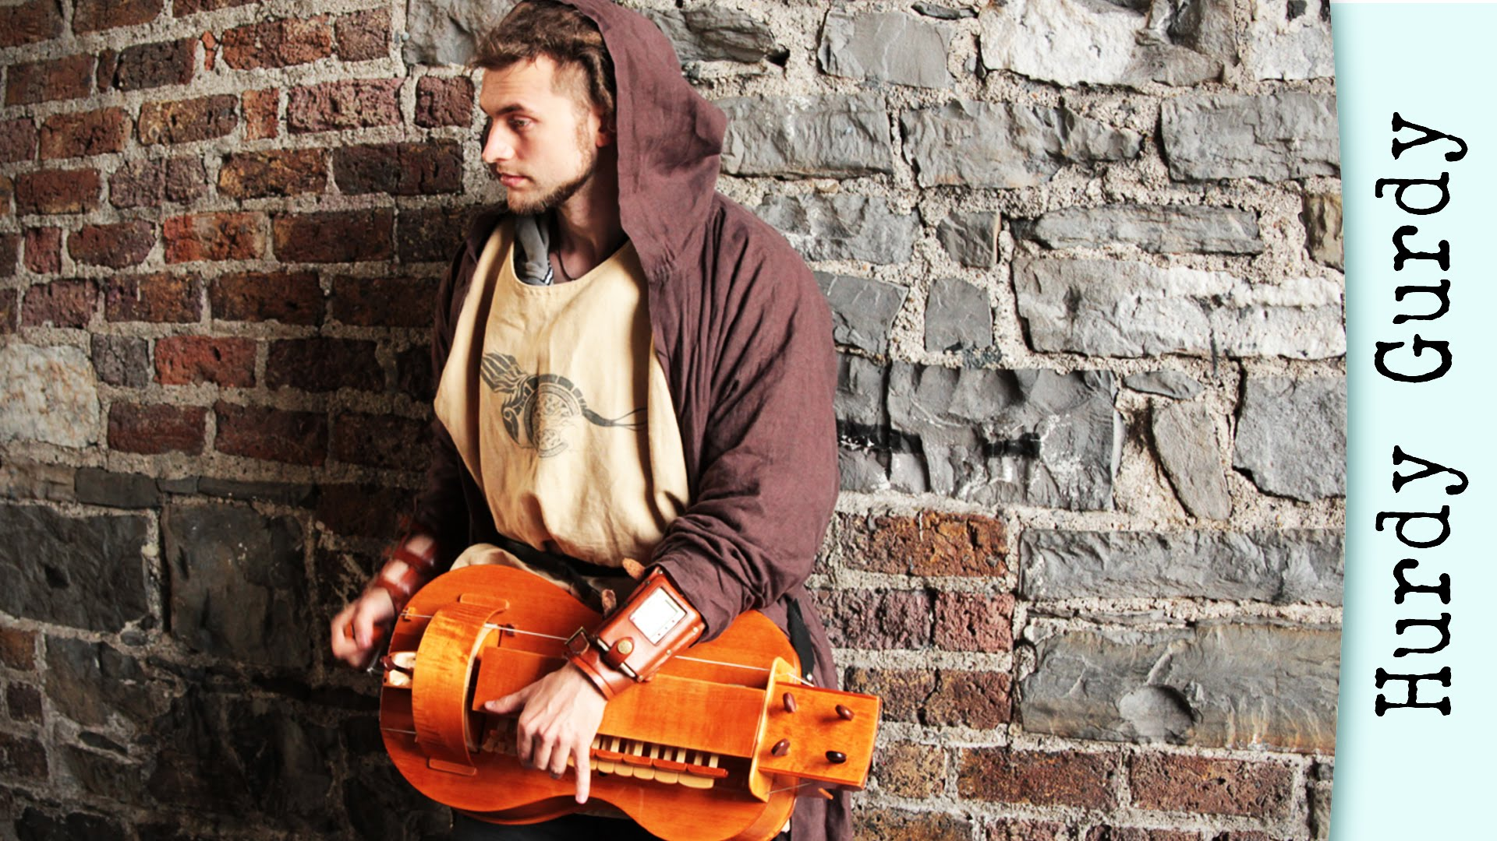
Hurdy-Gurdy
Stringed Instrument
Hand cranked to make sound
Crank moves string much like a bow would
Sounds like violin

Slide 3
Hurdy Gurdy Makes sounds

Slide 4
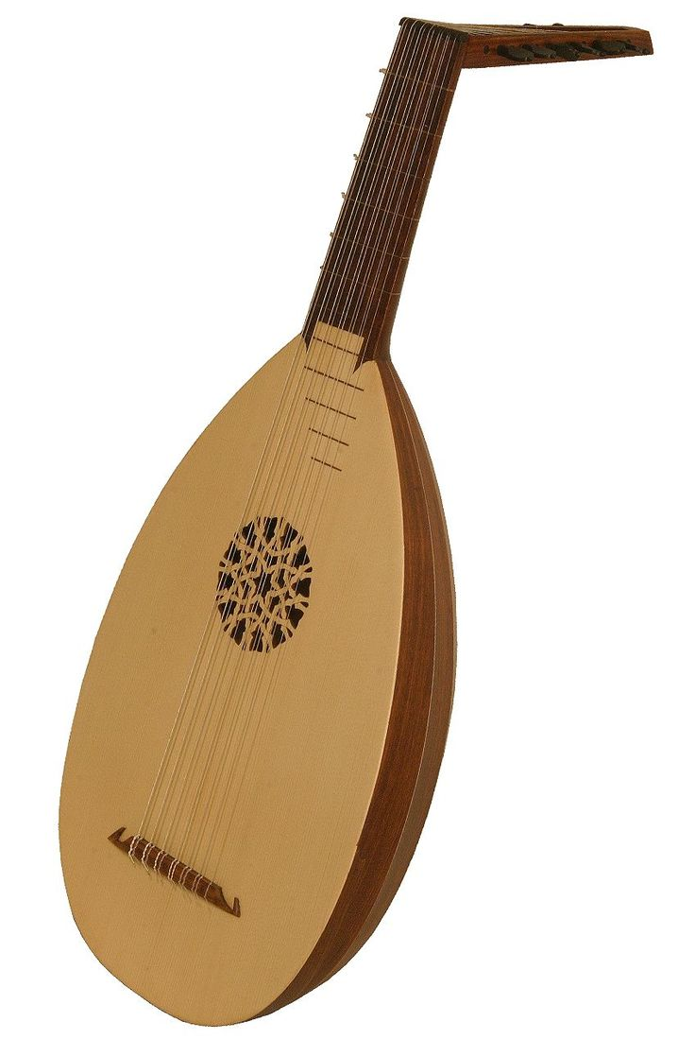
Lute
Early guitar
Rounded body
Bent neck
No set number of strings

Slide 5
Playing the Lute

Slide 6
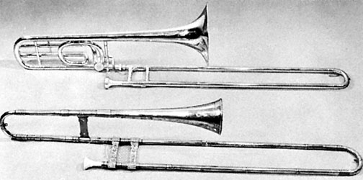
Sackbut
Modern day trombone

Slide 7
Sackbut Sound

Slide 8
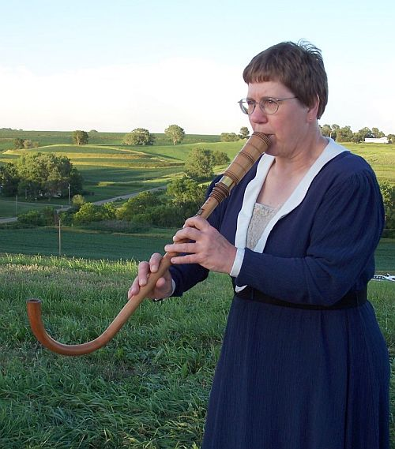
Crumhorn
Woodwind
Capped Reed Instrument
Limited range
6 holes

Slide 9
Crumhorn

Slide 10
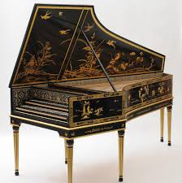
Harpsichord
String Instrument
Plucked to make sound
Looks like a keyboard
No drastic volume changes

Slide 11
Harpsichord

