Slide 1
Guitar Parts

Slide 2
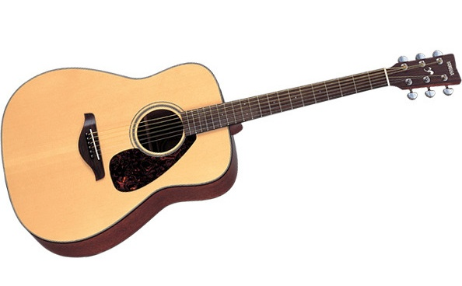
Sound Hole

Slide 3
Head
Or Headstock

Slide 4
Body

Slide 5
Tuners,
Tuning Pegs,
Tuning Machines
Tuning Mechanisms

Slide 6
Pickguard

Slide 7
Saddle
(Pointing to the white line)

Slide 8
Fingerboard

Slide 9
Nut

Slide 10
Bridge

Slide 11
Neck

Slide 12
Frets
(Metal lines that break up fingerboard)

Slide 13
Bridge Pins
(Six white circles that hold down the strings)

Slide 14
Strings
(Six things you strum to make sound)

Slide 15
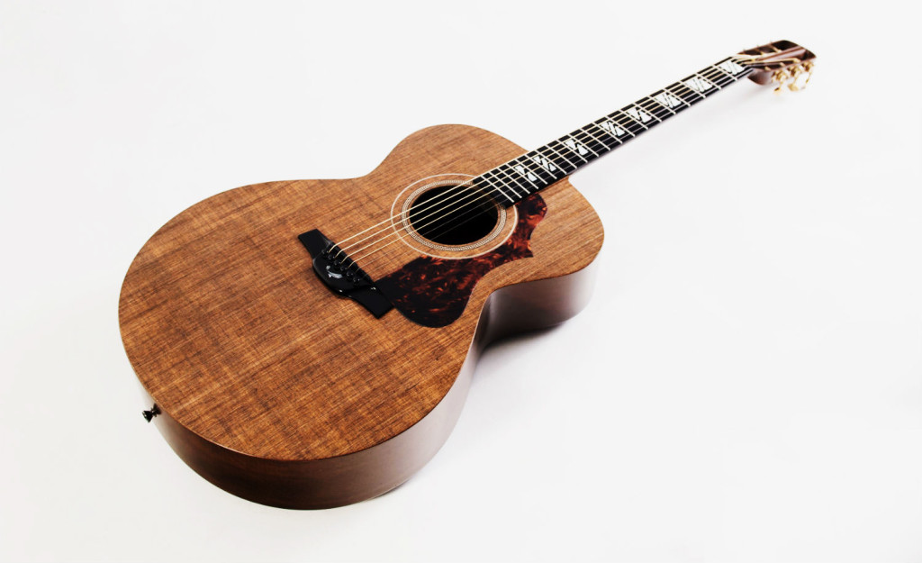
End Button or
End Pin

