Slide 1
Renaissance

Slide 2
Began
Florence, Italy (1350-1400)
Philosophy
Study of knowledge, reality, existence
Humanism: potential value of life
Government: Election
Medieval Times (Dark Ages)/Renaissance (Rebirth/Enlightenment)

Slide 3
Daily Life
Spending more money on clothes
Bigger homes for the middle class
School for wealthy boys
Toilets
Cannon and muskets
No need for knights

Slide 4
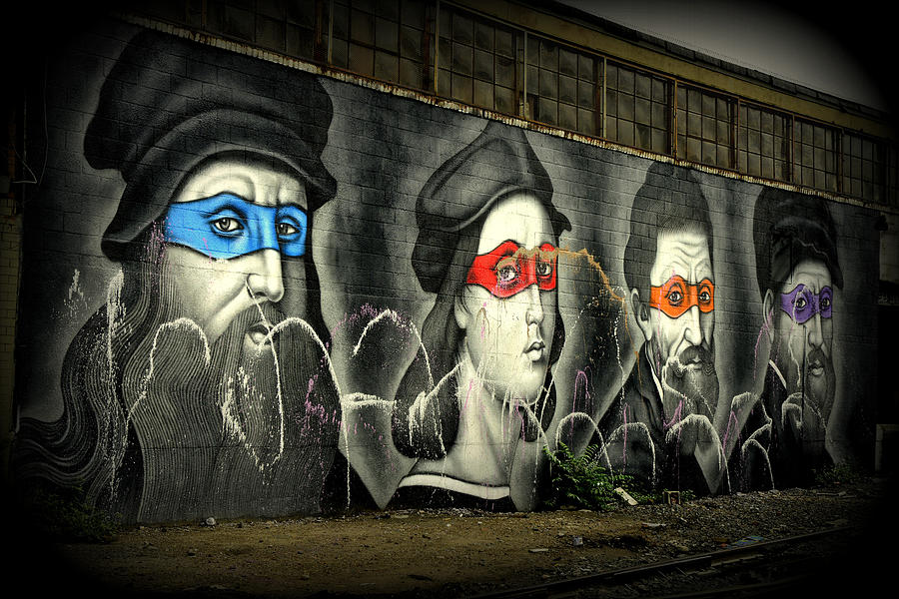
Culture

Slide 5
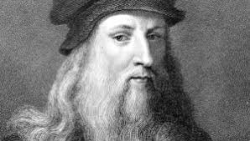
Leonardo Da Vinci

Slide 6
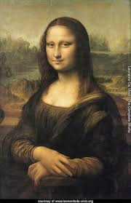
Mona Lisa

Slide 7
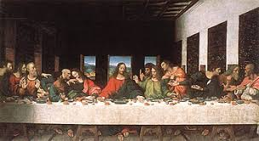
Last Supper

Slide 8
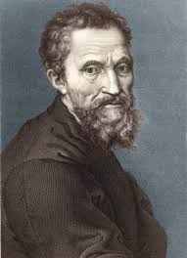
Michelangelo

Slide 9
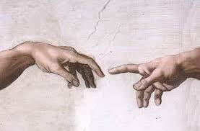
Sistine Chapel

Slide 10
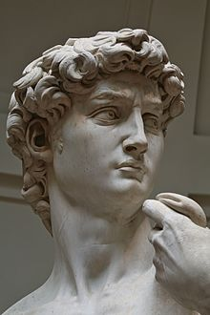
David

Slide 11
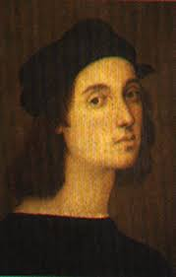
Rafael Sanzio

Slide 12
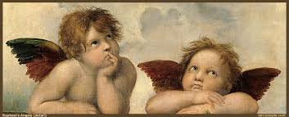
Cherubs

Slide 13
Donatello di Niccolò

Slide 14
Sciences
Study of the human body
Science and art are related
Scientific Method
Printing Press
Gutenberg Printing Press
Galileo
Studied “Universal Math”
Pendulum

Slide 16
Types of Music
Choirs
Started in church
Polyphonic music sang by large groups
Madrigals
3-6 singers
Polyphonic
Romantic Poems with emotion
Monteverdi composed the first dramatic opera

Slide 18
Instruments
Violin
Invented in 1500’s
Bagpipes and Recorder became popular
Lute and Hurdy Gurdy still in use
Instruments were considered less important than voices

Slide 19
Dancing
Court
Formal
Trained dancers
Form of entertainment
Country (informal in villages)
Anyone could participate
Different types of dances that had certain moves

Slide 20
Renaissance Is?
Movement of flourishing artistic expression (arts, music, poetry, dance) and cultural activity (things to do/events)

